Slide 1
Solar surface circulation velocities and magnetic fields from cycle 22 to early cycle 24
Supported in part by NSF grant AGS-0958779 and NASA grant NNX09AB12G.
Roger K. Ulrich
Division of Astronomy and Astrophysics, Department of Physics and Astronomy, University of California at Los Angeles
http://ulrich.astro.ucla.edu/SolarSurfaceDynamics.html

Slide 2
Solar surface dynamics
Observations of surface velocities from the Mt. Wilson Observatory 150-foot tower telescope.
Use solar rotation to divide into N/S (meridional) flow and E/W (zonal) flow.
These slides emphasize the zonal flow as manifested in the Torsional Oscillations.

Slide 3
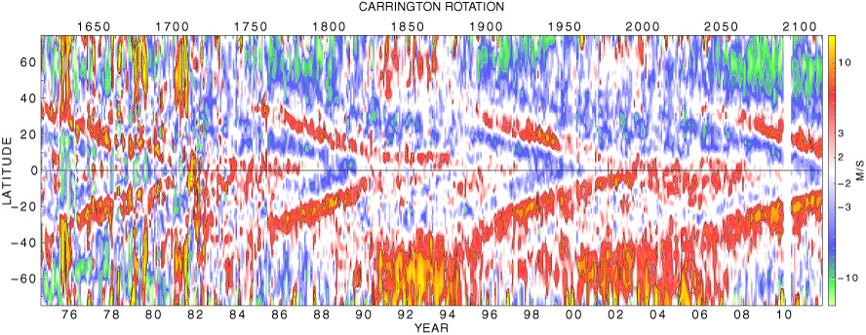
Torsional Oscillation
This figure shows the deviation from the standard rotation curve as a function of latitude and time.
The N/S asymmetry in rotation rate confuses the torsional oscillation pattern and is removed by averaging the two hemispheres.

Slide 4
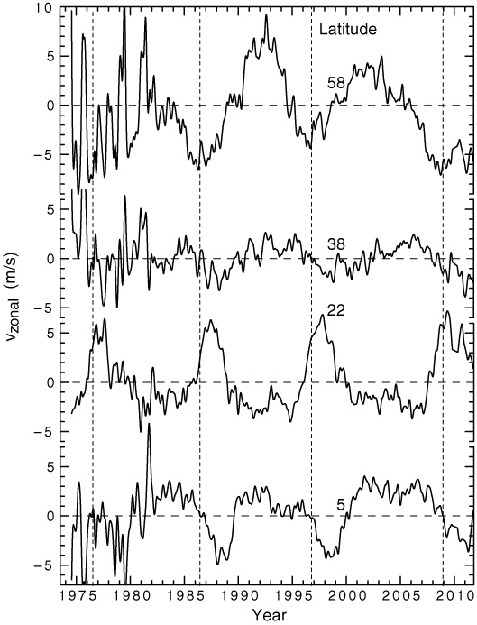
Torsional Oscillations as time trends
The zonal velocity is a travelling pulse at low latitudes.
Isolate features by fitting maxima and minima of time trends.

Slide 5
Symmetric Torsional Oscillations
In this figure the north and south hemispheres have been averaged together and the reflected southern hemisphere is omitted..

Slide 6
Symmetric T.O. with overlay
The overlaid lines and colored bands are derived from a quadratic fit to the maxima and minima on the v_{zonal} versus time trend lines at each latitude.

Slide 7
Systematics of the T.O.

Slide 8
The T.O. and the Solar Cycle

Slide 9
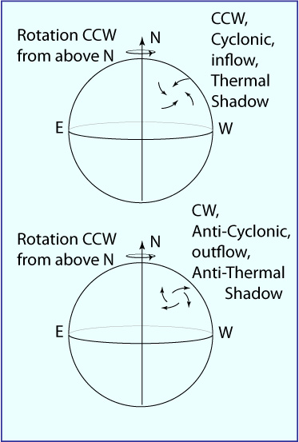
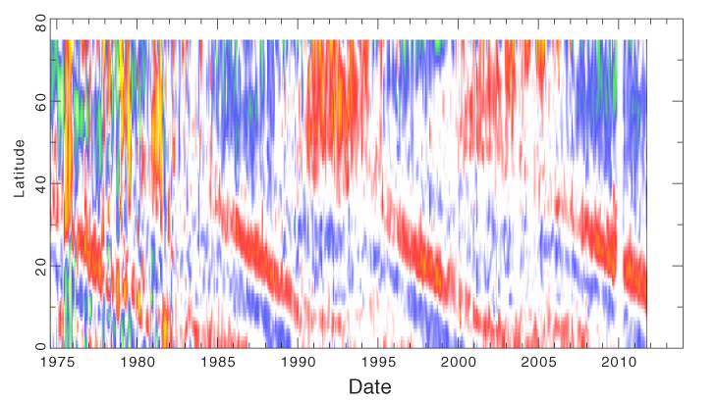
Defining the sense of local rotation eddys
A cyclonic eddy adds to the local rotation.
An anti-cyclonic opposes the local rotation.
Differential rotation is cyclonic.
The Torsional Oscillations have a strong zone that is anti-cyclonic.
Faster than average
Slower than average
Opposes rotation across this zone.

Slide 10
Definition of Rotation Shear
The strain rate tensor ε has a non-zero θ,φ component due to differential rotation.
The Torsional Oscillations are a local time dependent change of this component: δε_{θ,φ}.
The total strain rate is the sum of both contributions.
By analogy with wind shear we call ε_{θ,φ} the rotation shear.

Slide 11
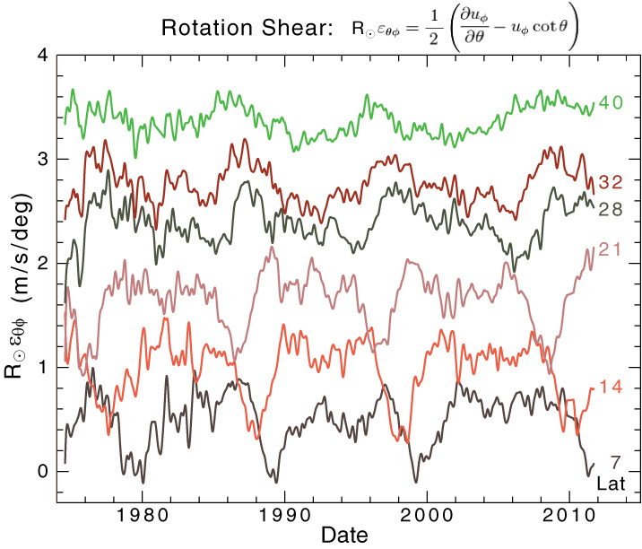
The T.O. as a rotation shear wave
This shows the total rotation shear from δv_{zonal} plus the effect of differential rotation.
The change δε_{θ,φ} due to the T.O. is large compared to ε_{θ,φ} Itself.
The differential rotation is cyclonic while the T.O. pulse is anti-cyclonic.

Slide 12
Rotation Shear Change vs Latitude and time
This 2-D Plot shows the concentrated anti-cyclonic pulse which lasts about 18 months. The decrease in rotation shear is a substantial fraction of the background from differential rotation.

Slide 13
The rotation shear precedes sunspots
This figure compares the times and latitudes of sunspots to the propagation of the anti-cyclonic rotation pulse. All available cycles are combine using time relative to sunspot number minimum. The rotation shear scale is for the darkest parts to have δε = -0.6 and the lightest parts to have δε = 0.1. The sunspot locations are shown by Hathaway(2011) according to a system separating cycle strength and spot group size.

Slide 14
Meridional flow deviations near minimum
The position of the anti-cyclonic pulse is shown by the vertical bars. The curves show the deviation of the meridional circulation velocity from the overall average. Each circulation curve is the average of the N and S hemispheres. Dashed lines show where the deviation is zero.
The anti-cyclonic pulse is partly aligned with the location of upwelling as indicated by the meridional circulation.

Slide 15
Some Numbers:
Solar minima based on the Torsional Oscillations were at 1976.4, 1986.7, 1996.9 and 2008.7.
The Torsional Oscillation anti-cyclonic pulse drifts at a rate of 4.2 degrees/year toward the equator.
Cycle 24 maximum is projected to occur at 2013.1±1. This projection will be updated at the end of 2011 and should have a reduced uncertainty.

Slide 16
Conclusions:
Torsional oscillations are predictive of the solar cycle development.
The Torsional oscillations are a propagating rotation shear pulse.
Rotation shear drops then recovers in a space of 18 months.
Activity appears about 18 months after the rotation shear recovers.
Meridional flow indicating upwelling is partly aligned with the anti-cyclonic rotation shear pulse.
The anti-cyclonic pulse suggests “anti-thermal shadowing”.
A numerical representation of the pulse is available on the next slide which is included in the web site posting.

Slide 17
Numerical Representation

Slide 18
High latitude rotation shear change is small

Slide 19
Meridional Flow
The flow pattern migrates from pole toward equator (the flow itself is from equator to pole except near the poles.
The polar reverse flow is strongest near sunspot minimum and absent for cycle 23

Slide 20
Time Dependence of the Meridional Flow
The flow at all latitudes has dropped to very low levels at the start of cycle 24.
The duration of the low flow rate is longer than any previous period.

Slide 21
Latitude Dependence of Meridional Flow
The latitudinal dependence of the meridional flow is at record low values throughout the sun except for a band within 10 degrees of the equator.

Slide 22
Magnetic – Sectoral Component
The polar field has not yet reversed.
The cycle 23 field was half the cycle 21 and 22 fields.

Slide 23
Reference summary

Slide 24
References

